Slide 1
Question Generation Using RAG

Slide 2
Problem Statment
Educational assessment faces challenges in efficiency, consistency, and cognitive depth when generating questions. Traditional methods are time-consuming and often fail to address various thinking skills adequately. There's a growing need for an innovative approach that can automate question creation while ensuring quality and relevance across different cognitive levels. By combining Retrieval-Augmented Generation (RAG) with Bloom's Taxonomy, we aim to develop a system that efficiently produces diverse, contextually relevant questions. This solution would streamline the assessment process, reduce educator workload, and improve the evaluation of student learning across multiple cognitive domains, ultimately enhancing educational outcomes.

Slide 3
Introduction
Automated question generation (QG) using neural networks is revolutionizing education, research, and conversational AI. The Retrieval-Augmented Generation (RAG) framework combines pre-trained language models with a retrieval mechanism to generate contextually rich questions. Users can control the number and difficulty of questions, enhancing flexibility. By integrating Bloom's Taxonomy, which classifies learning objectives into cognitive levels (e.g., Remembering, Analyzing, Creating), RAG-based systems tailor questions to specific learning outcomes. This technology enables scalable, customized question generation for educational assessments, research queries, and interactive AI, offering a powerful tool for personalized learning and engagement across various domains.

Slide 4
Literature Review
https://docs.google.com/spreadsheets/d/17RdjM1IDlqyHLy8pHteRO_OStw1MRxIF5KXP0qsKuAM/edit?usp=sharing

Slide 5
Research Challange
Dataset Creation:Developing a comprehensive dataset that accurately represents all levels of Bloom's Taxonomy
Context Window Optimization [RAG]:Determining the optimal size of the context window for different types of educational content and question complexity.Balancing the need for comprehensive context with the limitations of LLM token capacity.

Slide 6
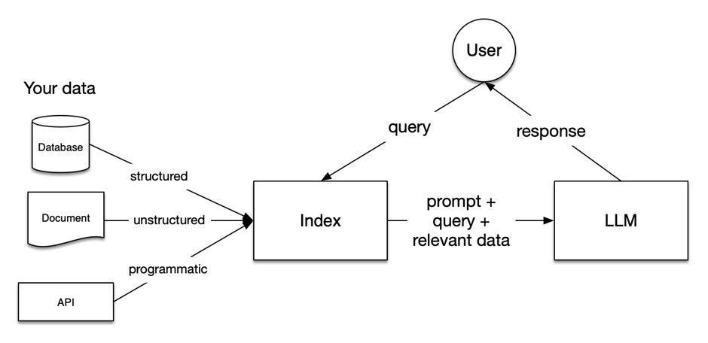
Methodology

Slide 7
Reference
Generating Questions for Knowledge Bases via Incorporating Diversified Contexts and Answer-Aware Loss. Cao Liu and Kang Liu and Shizhu He and Zaiqing Nie and Jun Zhao. EMNLP, 2019.
Difficulty-controllable multi-hop question generation from knowledge graphs. Vishwajeet Kumar and Yuncheng Hua and Ganesh Ramakrishnan and Guilin Qi and Lianli Gao and Yuan-Fang Li. ISWC, 2019.
Cross-Lingual Training for Automatic Question Generation. Vishwajeet Kumar and Nitish Joshi and Arijit Mukherjee and Ganesh Ramakrishnan and Preethi Jyothi. ACL, 2019.
Neural question generation with answer pivot. Wang, Bingning and Wang, Xiaochuan and Tao, Ting and Zhang, Qi and Xu, Jingfang. AAAI, 2020.
Learning to ask more: Semi-autoregressive sequential question generation under dual-graph interaction. Zi Chai and Xiaojun Wan. ACL, 2020.

